Slide 1

University College of Engineering, Tindivanam
(A Constituent College of Anna University, Chennai)
Department of Information Technology
TITLE
Design and Evaluation of a Static Analyzer Based Design Pattern Analyzer for High-Level Languages
(Python Case Study)
BATCH NO: 3
SUPERVISOR: Dr. R. Shyamala, M.E.,Ph.D.,AP/IT
Team Members:
422422205007 NARESH M
422422205027 HARIHARAN S R
422422205032 RAKSHAYA S

Slide 2
S.No | Paper (Author,Title, Journal Name,Year) | Key Idea / Approach | Advantages | Disadvantages | Evaluation Metrics | Data Set (if required)
1 | Yama:Precise Opcode-Based Data Flow Analysis for Detecting PHP Applications Vulnerabilities (2025) | Performs context-sensitive interprocedural taint analysis on Zend Opcodes rather than source code. Uses a two-step approach: 1) CFG construction from jump instructions; 2) Forward data flow with type inference. | High precision due to clear control flow in opcodes Effective at identifying zero day vulnerabilities (38 found). | Lacks sophisticated constraint-solving coarse granularity intaint sanitization. | 1.True Positive Rate (99.1%) 2.Number of CVE IDs assigned (34). | 24 popular GitHub projects with >1,000 stars (Real-world PHP apps).
2 | ForBac: A Static Analysis Approach With Forward and Backward Analysis for Precision in Floating-Point Computations(2025) | Combines forward analysis (tracking error propagation) with backward analysis (calculating minimal input precision required) using Abstract Interpretation on Interval domains. | Dual input: Source+ bytecode features 95.78%: Average accuracy 8 types: Common vulnerabilities | Enhances precision in safety-critical Systems. Provides a scalable solution for numerical inaccuracies. | 1.Computational overhead from iterative forward-Backward passes. | Standard numerical benchmarks: Newton Raphson, Jacobi Iteration, and PolyBench/C.

Slide 3
3 | The Best of Abstract Interpretations (POPL 2025) | Proposes a formal logic to define and prove "Best Correct Approximations" (bca). Focuses on the absolute upper bound of precision for any given abstract domain. | Provides an absolute upper bound for Precision Minimizes false alarms. | Theoretical complexity The property of being "the best" is not naturally compositional | 1.Proof of validity for abstract triples 2.Precision gain over non-bca methods.
4 | CoSSJIT: Combining Static Analysis and Speculation in JIT Compilers (2025) | Integrates expensive static points-to analysis into a JIT compiler. It "speculates" that static results remain valid at runtime, falling back only if checks fail. | Achieves 5.7x improvement in stack allocation Bridges the gap between static precision and run-time specialization. | .Requires modifications to production JIT compilers Potential for speculation failure. | 1.Performance speedup 2.Stack allocation efficiency 3.Functional correctness. | Production Java Virtual Machine and large-scale Java programs.
5 | PHU+0050Joy: A Novel Extended Graph Based PHP Code Analysis Framework (2025) | Maps PHP code to an Extended Semantic Graph that merges AST, CFG, and PDG. Uses a specialized graph query framework with a high performance cache. | Reduces runtime analysis overhead by 76.54% Improves semantic edge discovery by 23.76%. | 1.Large memory footprint for storing massive semantic graphs (269M+ edges). | 1.Runtime overhead reduction 2. Semantic edge discovery rate. | 333 popular open-source PHP programs.

Slide 4
Deep Static Analysis: Map Python code structures without execution to identify hidden architectural flaws.
Structural Verification: Ensure strict adherence to formal patterns (Singleton, Factory, Observer).
Quality Quantification: Generate a Global Design Quality Index (GDQI) to grade architectural integrity.
Abstract
Domain/ Area: Compiler Design, Static Analysis
Problem statement
Most tools only check if Python code "runs," but they miss "hidden" structural mistakes where a developer says they are using a Design Pattern but implements it incorrectly.
Objectives
Deep Static Analysis: Map Python code structures without execution to identify hidden architectural flaws.
Structural Verification: Ensure strict adherence to formal patterns (Singleton, Factory, Observer).
Quality Quantification: Generate a Global Design Quality Index (GDQI) to grade architectural integrity.
Proposed Solution
Semantic Graph Extraction: Leveraging the Scalpel framework to generate high-fidelity Intermediate Representations, including AST (Abstract Syntax Trees) and CFG (Control Flow Graphs).
Heuristic Inference Engine: A rule-based system that correlates semantic graphs against formal design constraints to verify structural soundness.
Erosion Detection: Identifying "shallow" implementations where code is syntactically functional but architecturally unsound.
1. To design a sound static analysis framework for Python based on abstract interpretation.
2. To represent program behavior using abstract states that capture possible variable values and control-flow conditions.
3. To analyze loops and control-flow constructs using fixpoint computation to ensure safe and finite analysis.
4. To improve analysis precision through flow-sensitive and path-sensitive data-flow analysis while preserving soundness.
5. To implement and demonstrate a prototype static analyzer capable of detecting potential runtime errors in Python programs.

Slide 5
Deep Static Analysis: Map Python code structures without execution to identify hidden architectural flaws.
Structural Verification: Ensure strict adherence to formal patterns (Singleton, Factory, Observer).
Quality Quantification: Generate a Global Design Quality Index (GDQI) to grade architectural integrity.
Operational Feasibility & Technical Feasibility
1. Software Requirements
Operating System: Windows 10/11 or Linux (Ubuntu 20.04+). Linux is preferred for better regex and file system handling.
Programming Language: Python 3.9+. (Chosen for its robust AST libraries and rapid prototyping capabilities).
Libraries/Frameworks:
ast : For parsing source code into tree structures.
Graphviz: For generating visual representations of the DFD and pattern structures.
IDE: VS Code or PyCharm (integrated with debugging tools for tree traversal).
2. Hardware Requirements
Processor: Intel Core i5 or AMD Ryzen 5 (Minimum 11th Gen). Required for efficient AST generation and pattern matching.
RAM: 8 GB (16 GB Recommended). Necessary to hold large code-graphs in memory during the analysis phase.
Storage: 256 GB SSD. SSD is critical for fast I/O when reading large source code directories.
GPU: Not required
1. To design a sound static analysis framework for Python based on abstract interpretation.
2. To represent program behavior using abstract states that capture possible variable values and control-flow conditions.
3. To analyze loops and control-flow constructs using fixpoint computation to ensure safe and finite analysis.
4. To improve analysis precision through flow-sensitive and path-sensitive data-flow analysis while preserving soundness.
5. To implement and demonstrate a prototype static analyzer capable of detecting potential runtime errors in Python programs.

Slide 6
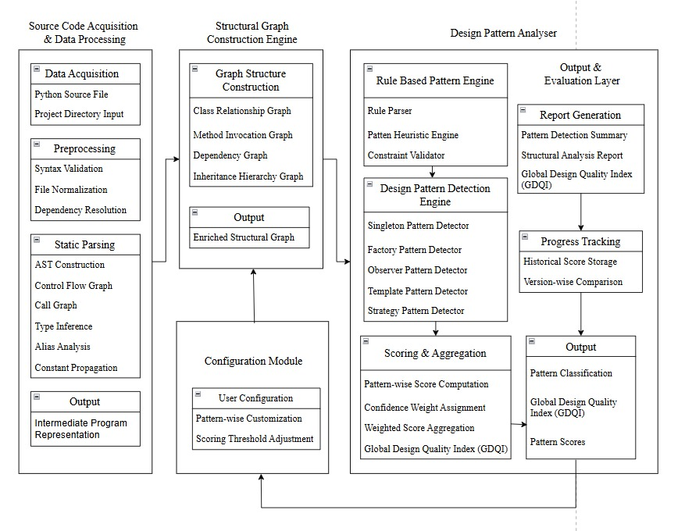
System Architecture

Slide 7
List of Modules
Module 1: Data Acquisition & Preprocessing: Scanning the project folder to find and prepare .py files for analysis .
Module 2: Scalpel Integration & Graph Construction: Using the Scalpel library to turn raw code into a "logic map" (AST and CFG) .
Module 3: Pattern Intelligence & Rule Engine: The core analytical module responsible for matching enriched structural graphs against codified design standards using fixpoint computation.
Module 4: Quality Evaluation & Reporting:
Translating raw detection metrics into actionable insights through weighted scoring and comprehensive reporting

Slide 8


Vector-Based Detection Framework
Multi-Modal Graph Generation: Converts raw Python source code into Abstract Syntax Trees (AST) for structural mapping and Control Flow Graphs (CFG) for execution path validation.
Feature Vectorization: Deploys the 5 specialized detectors to evaluate the AST/CFG. Instead of returning binary true/false flags, it generates a composite Feature Vector (V_target) representing structural traits (e.g., polymorphism, gateways, registries).
Archetype Matching (Cosine Similarity): Overcomes brittle rule-matching by calculating the geometric similarity between the extracted vector (V_target) and an ideal pattern archetype vector (V_ideal).
GDQI Aggregation: Computes the overall architectural health by aggregating the continuous pattern scores applying algorithmic confidence weights.

Slide 9
Singleton Algorithm
Description: Analyzes the Abstract Syntax Tree (AST) for restricted instance variables and traverses the Control Flow Graph (CFG) to mathematically verify branch divergence (instantiation vs. bypass paths).
Input: Source Code File (Parsed into AST and Scalpel CFG).
AST Gateway Validation: Scan the AST to identify class-level variables initialized to None and isolate control methods (__new__ or @classmethod).
CFG Matrix Construction: Convert the Scalpel CFG into an Adjacency Matrix, specifically tagging nodes that contain conditions, assignments, or returns involving the tracked variable.
Path Traversal (Branch Divergence): Traverse the adjacency matrix to verify two strict routes: an Instantiation Path (Condition -> Assignment -> Return) and a Bypass Path (Condition -> Return without assignment).
Vector Assembly: If both paths are verified, compile the structural data into a feature vector, evaluating strength based on the control method used.
Output: A 4x1 numpy Feature Column Matrix (representing [Gateway, Divergent_Paths, Safe_Return, Enterprise_Strength]) alongside verification evidence.

Slide 10
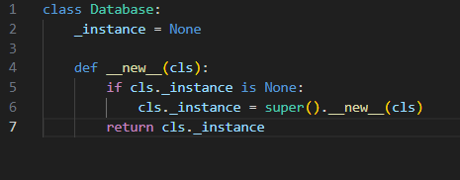
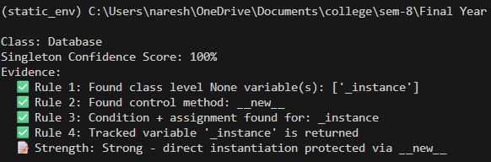
Module Implementation
Singleton Detector
Source Code : static-analyzer-for-analysis-of-design-pattern/architecture-tutor-project/src/architecture_tutor/singleton_detector.py at main · naresh-webdev/static-analyzer-for-analysis-of-design-pattern
The Singleton confirms that only one instance can exist by verifying the __new__ method logic in the AST.

Slide 11
Factory Algorithm
Description: Evaluates the Abstract Syntax Tree (AST) hierarchically to detect object creation delegation through polymorphic interfaces, dictionary registries, or conditional branching.
Input: Source Code File (Parsed into AST).
True Factory Validation (Strongest): Traverse the AST to identify abstract base classes (ABC) containing @abstractmethod decorators, verifying that multiple concrete subclasses override the method to return specific instances.
Registry Factory Check (Medium): If no abstract interface exists, scan for dictionary assignments (class or instance variables) mapping keys to object types, followed by a method executing a subscript lookup and instantiation.
Simple Factory Fallback (Weakest): If no registry is found, inspect methods for parameterized inputs driving if/elif control flows that yield multiple distinct object types.
Vector Assembly: Classify the detected architecture based on the highest matched variant and generate the corresponding matrix flags.
Output: A 4x1 numpy Feature Column Matrix representing [Gateway, Parameterization, Registry, Polymorphism], accompanied by architectural evidence and refactoring suggestions.

Slide 12
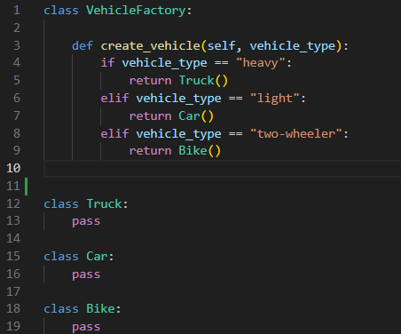
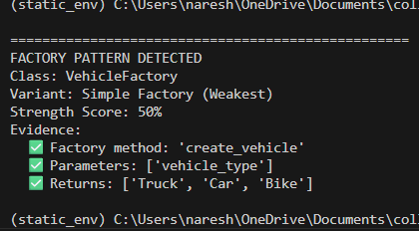
Module Implementation
Factory Detector
Source Code : static-analyzer-for-analysis-of-design-pattern/architecture-tutor-project/src/architecture_tutor/factory_detector.py at main · naresh-webdev/static-analyzer-for-analysis-of-design-pattern
The Factory identifies the create_vehicle method and verifies it returns the correct object types (Truck, Car, Bike)

Slide 13
Observer Algorithm
Description: Identifies event-driven publisher-subscriber architectures by tracking collection initializations, detecting loop-based broadcast delegations, and using Control Flow Graphs (CFG) to mathematically verify listener execution paths.
Input: Source Code File (Parsed into AST and Scalpel CFG).
State Tracking (Gateway): Scan __init__ methods within the AST to locate lists or sets initialized specifically to store object references.
Registration Mapping: Identify class methods that actively append or add external objects to the tracked collection.
Broadcast Detection: Locate methods containing for loops that iterate over the collection and dynamically discover the target trigger method (e.g., obj.update()) invoked on the items.
Listener Ecosystem Verification: Traverse the rest of the AST to confirm that other classes actually implement the dynamically discovered trigger method.
Execution Proof: Analyze the Scalpel CFG to mathematically prove a valid execution path exists that guarantees the invocation of the target method.
Output: A 5x1 numpy Feature Column Matrix representing [Gateway, Registration, Broadcast, Listeners, CFG_Proof], accompanied by architectural evidence and ecosystem suggestions.

Slide 14
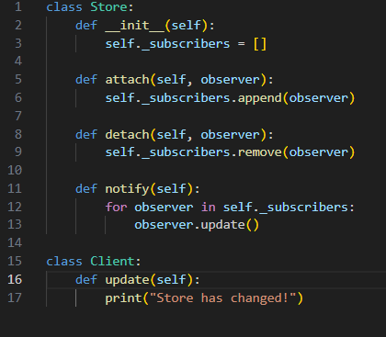
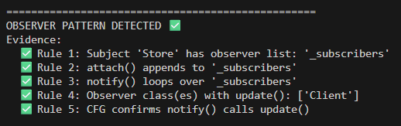
Module Implementation
Observer Detector
Source Code : static-analyzer-for-analysis-of-design-pattern/architecture-tutor-project/src/architecture_tutor/observer_detector.py at main · naresh-webdev/static-analyzer-for-analysis-of-design-pattern
The Observer uses the Control Flow Graph (CFG) to prove that notify() successfully triggers the update() function

Slide 15
Template Algorithm
Description: Maps class hierarchies to identify Abstract Base Classes containing a concrete "skeleton" method that orchestrates execution by invoking its own deferred abstract methods.
Input: Source Code File (Parsed into AST).
Ecosystem Mapping: Traverse the AST to catalog Abstract Base Classes (ABCs), strictly separating their abstract methods from concrete methods while mapping the inheritance tree of all subclasses.
Skeleton Validation (Gateway): Scan the internal body of the ABC's concrete methods to detect if they make self.<method>() calls specifically targeting the class's own defined abstract methods.
Polymorphism Check: Cross-reference the mapped ecosystem to verify how many concrete subclasses exist to implement these deferred abstract steps.
Vector Assembly: Evaluate the template's usage based on child implementations and compile the findings into a matrix.
Output: A 3x1 numpy Feature Column Matrix representing [Skeleton, Has_1_Subclass, Has_Multiple_Subclasses], accompanied by structural evidence and usage suggestions.

Slide 16
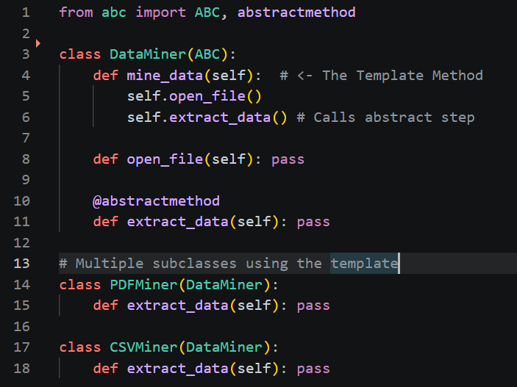
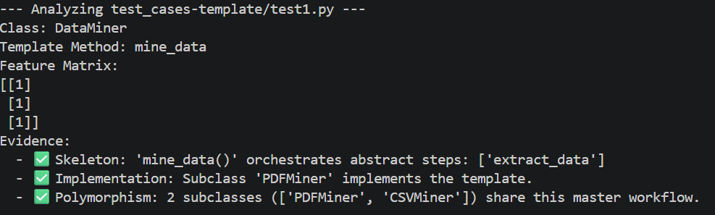
Module Implementation
Template Detector
Source Code :static-analyzer-for-analysis-of-design-pattern/architecture-tutor-project/src/architecture_tutor/template_detector.py at main · naresh-webdev/static-analyzer-for-analysis-of-design-pattern

Slide 17
Strategy Algorithm
Description: Evaluates class composition and delegation to identify dynamic algorithm swapping, verifying multiple interchangeable implementations, formal interface contracts, and type safety.
Input: Source Code File (Parsed into AST).
Ecosystem Mapping: Traverse the AST to index all Abstract Base Classes (ABCs), their abstract methods, and map out all concrete method implementations across the file.
Injection & Delegation (Gateway): Scan class definitions to identify state injected via arguments and stored as instance variables, then detect if the class delegates execution by calling methods on those injected objects (e.g., self.strategy.execute()).
Interchangeability Check: Cross-reference the delegated method with the mapped ecosystem to confirm if multiple distinct classes implement that specific behavior.
Contract & Type Verification: Validate if the delegated method is governed by a formal ABC interface, and check if the injected variable explicitly uses Python type hinting to enforce that contract.
Output: A 4x1 Feature Column Matrix representing [Basic_Structure, Multiple_Implementations, ABC_Interface_Used, Properly_Type_Hinted], accompanied by structural evidence and typing suggestions.

Slide 18
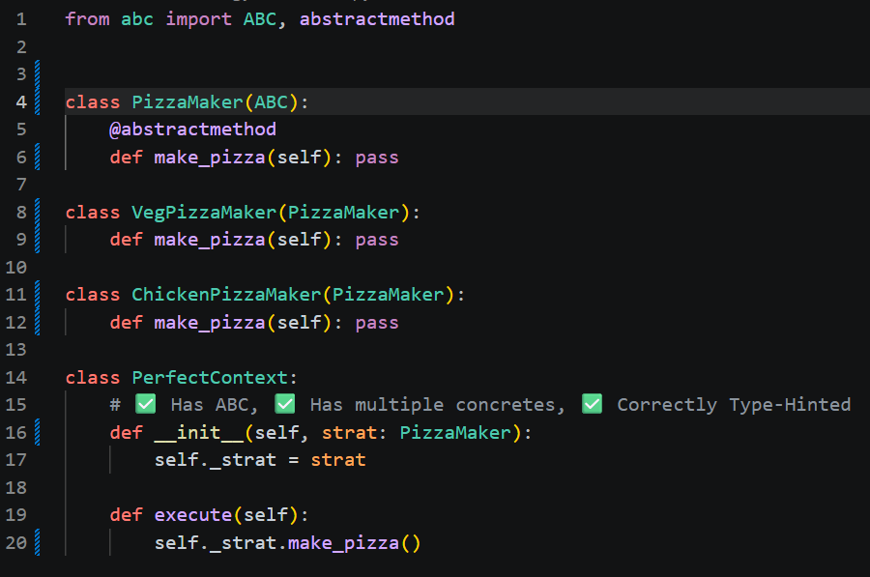
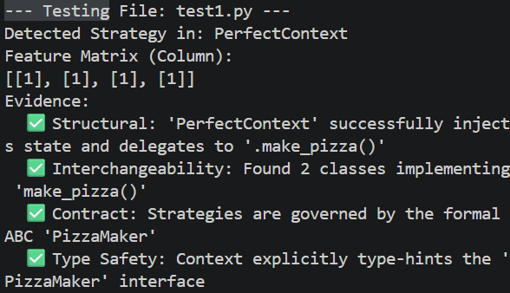
Module Implementation
Strategy Detector
Source Code :static-analyzer-for-analysis-of-design-pattern/architecture-tutor-project/src/architecture_tutor/strategy_detector.py at main · naresh-webdev/static-analyzer-for-analysis-of-design-pattern

Slide 19
Conclusion:
Bridging the "Soundness Gap": Successfully developed a static analyzer that prioritizes architectural integrity over simple syntax checking, effectively distinguishing between professional design patterns and "shallow" implementations.
Enriched Structural Analysis: Leveraged the Scalpel framework to move beyond text-based parsing, utilizing Abstract Syntax Trees (AST) and Control Flow Graphs (CFG) to map complex program logic as a formal mathematical "blueprint."
Quantitative Design Quality: Introduced the Global Design Quality Index (GDQI), providing developers with a measurable "Design Grade" to objectively assess and improve software architecture.
Operational Deployment: Reached the project goal by successfully publishing architecture-tutor as a live, production-ready package on PyPI, demonstrating cross-platform stability and real-world scalability.
Final Impact: The tool serves as a safeguard against architectural erosion, offering automated refactoring recommendations that ensure long-term code reliability and maintainability.

Slide 20
References :
Yama: Precise Opcode-Based Data Flow Analysis for Detecting PHP Applications Vulnerabilities
https://ieeexplore.ieee.org/document/11095739
2.ForBac: A Static Analysis Approach With Forward and Backward Analysis for Precision in Floating-Point Computations
https://ieeexplore.ieee.org/document/10990216
3.The Best of Abstract Interpretations
https://dl.acm.org/doi/epdf/10.1145/3704882
4.CoSSJIT: Combining Static Analysis and Speculation in JITCompilers
https://dl.acm.org/doi/epdf/10.1145/3763149
5.PHPJoy: A Novel Extended Graph-Based PHP Code Analysis Framework.
https://ieeexplore.ieee.org/document/11181216

